Slide 1
FACIAL RECOGNITION
Presented by:
Student name:A.Dinesh
College name:Salem college of Engineering and Technology
Department:Computer science and Engineering

Slide 2
PROBLEM STATEMENT
Currently employees of a particular corporate can share their login credentials to someone they know to give access for their account.

Slide 3
PROPOSED SOLUTION
Instead of giving username and password for employees,we can use facial recognization of that particular employee to get access for their workspace.

Slide 4
SYSTEM DEVELOPEMENT APPROACH
Commonly used face recognition systems like mobile phones unlock features.
This system can be integrated with a webpage and allow it to access camera function.

Slide 5
ALGORITHM AND DEVELOPEMENT
In developement phase implement common human face recognition algorithm like plasma photolabs.
Based on accuracy facial identies can be stored and can be used later recognition.

Slide 6
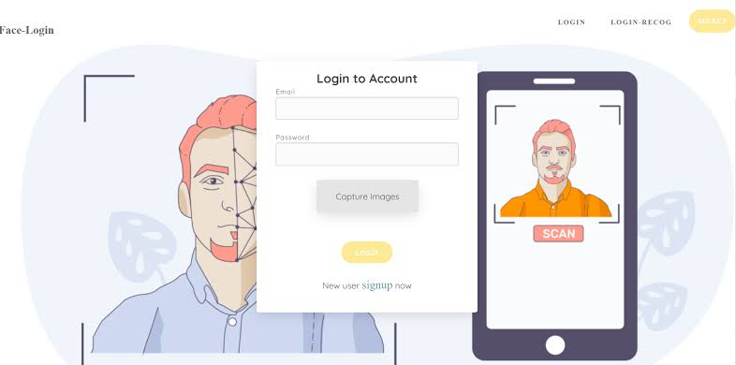
RECRUIT

Slide 7
CONCLUSION
In conclusion facial recognition for user login in particular domain based corporate will be effective for companies.

Slide 8
FUTURE SCOPE
Can be implemeneted in open user allowance instead of using in particular field.
Social medias,banking sectors can also use this system.

